Slide 1


RHNA Preview
January 11, 2023
Rockingham Planning Commission
RHNA PROJECT WEBPAGE:
www.therpc.org/RHNA
Notes:
RECORD SESSIONS

Slide 2
Agenda
Purpose of an RHNA & Project Overview
Factors Impacting Regional Housing
Regional Projections
Opportunity in the Region
The Future of Housing
Next Steps & Q&A

Slide 3
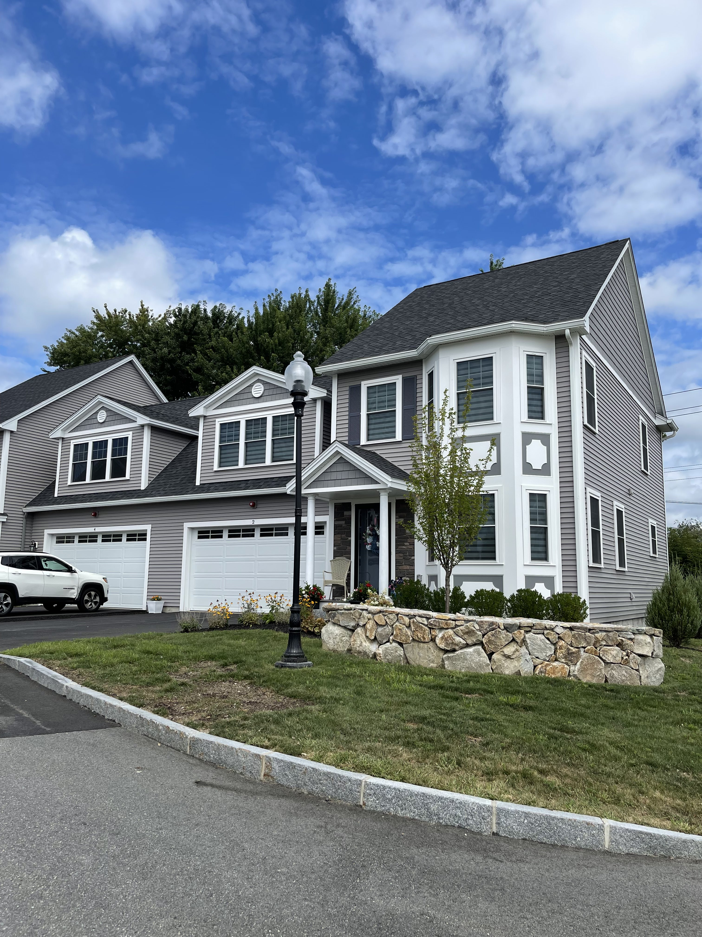
Purpose & History of an RHNA
“To provide data on housing and demographics, by income level, so that each municipality on the region can begin to understand their current and future housing need.”
Fulfill statutory requirements (RSA 36:47(II))
ARPA Funding Requirements
Council on Housing Stability Strategic Plan (2021-2024)
Assist in determining compliance with Workforce Housing Statute (RSA 674:58-61)
II. PURPOSE OF THE RHNA
Notes:
(advisory!)
New Hampshire RSA 36:47(II) requires that “For the purpose of assisting municipalities in complying with RSA 674:2, III(l), each regional planning commission shall compile a regional housing needs assessment, which shall include an assessment of the regional need for housing for persons and families of all levels of income.”
Council on Housing Stability – Conduct affordable housing needs assessment to determine the housing deficit, determine barriers to affordable housing and what may be done to remove barriers

Slide 4
RHNA Outreach Overview
Statewide Coordination
6 Surveys
Community Survey
Employer Survey
Municipal Questionnaire
NH Realtors Survey
Social Service Provider Survey
Landlord & Property Manager
Community Events & Forums
Additional Regional & Statewide Outreach
III. RHNA OUTREACH SUMMARY
Notes:
Six Surveys (3 regional, 3 statewide)
Community Survey: 329 Responses
Employer Survey: 197 Responses
Municipal Questionnaire: 24 Responses
NH Realtors Survey: 209 Responses
Social Service Provider Survey: 72 Responses
Landlord & Property Management Survey: 46 Responses
Community Events & Forums
A Regional Conversation on Housing: Tackling the Important Issues
Exeter Housing Advisory Committee Regional Roundtable Event, Community Forum
RHNA Advisory Committee
Representatives including Realtor, State Representative/Select Board Member, Local Employer, developers, housing advocate
Two Municipal Roundtable Discussions
RPC Commissioner and Municipal Officials Forum
Additional Input from Regional & Statewide Outreach that Informed this RHNA
Age Friendly Communities Housing Findings
Council on Housing Stability, Developer Survey
Local Employer Interviews
Participation in numerous regional and local housing events and discussions

Slide 5
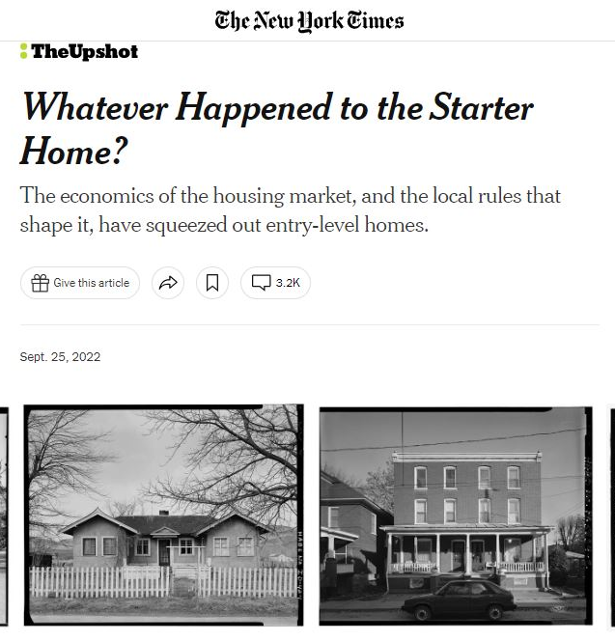
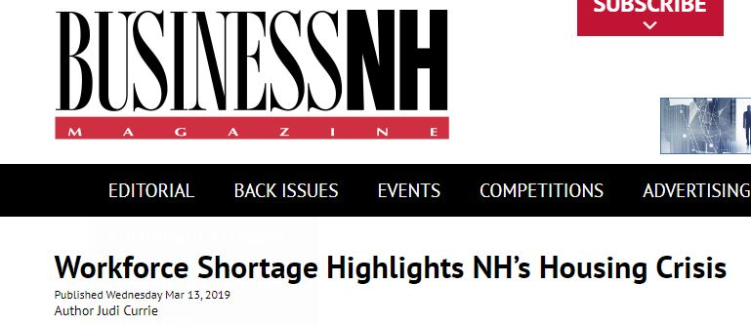
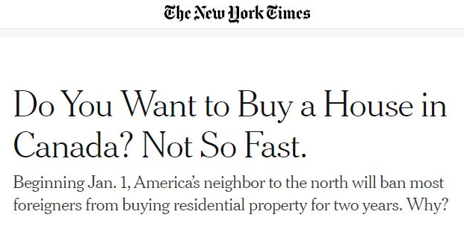

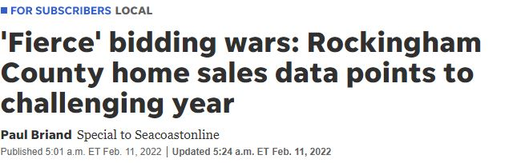
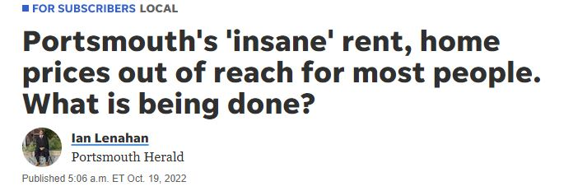
Notes:
[https://www.communitiesandconsequences.org/videos/]

Slide 6
Factors Impacting Regional Housing
Regional population is increasing.
Regional population is aging.
Housing Production has slowed.
Cost of housing is increasing.
Employment trends & in-migration are changing the market.
Current housing stock does not meet the needs of our communities.
Income has lagged as housing prices continue to increase.
IV. HISTORICAL & EXISTING CONDITIONS AND TRENDS

Slide 7
Regional Population is increasing.
2000: 177,962
2010: 188,521
2020: 198,870
2040: 221,897
IV. HISTORICAL & EXISTING CONDITIONS AND TRENDS
Notes:
2000 – 2010 +10,559
2010 – 2020 +10,349
PROJECTED
2020 – 2030 +15,868
2030 – 2040 +7,159

Slide 8
Regional Population is aging.
Average Age:
2010: 43
2020: 47
IV. HISTORICAL & EXISTING CONDITIONS AND TRENDS

Slide 9

Housing production has slowed.
IV. HISTORICAL & EXISTING CONDITIONS AND TRENDS

Slide 10

Cost of housing is increasing for both renters and homeowners.
RPC Region
Median Gross Rent
+47%
2010: $1,086
2022: $1,595
RPC Region
Median Home Price
+99%
2010: $265,000
2022: $527,000
IV. HISTORICAL & EXISTING CONDITIONS AND TRENDS
Notes:
Affordable mortgage payment $2,537/$344,000 (assumption of 6.9% interest rate)
Affordable rent payment $1,369
2020
Regional Median Income :
Owner $101,480
Renter $54,754

Slide 11
Employment trends & in-migration are changing the market.
Where NH Homebuyers are Coming From
State | 2016 | 2017 | 2018 | 2019 | 2020 | 2021 | 2022*
NH | 74.7% | 74.6% | 73.7% | 74.8% | 71.5% | 68.4% | 71.3%
MA | 14.7% | 14.9% | 15.7% | 14.9% | 17.8% | 19.0% | 15.8%
Other | 10.6% | 10.5% | 10.6% | 10.3% | 10.7% | 12.6% | 13.0%
“I can't see how town workers- teachers, safety, other- can afford to live in this town. Also, I imagine that part of our employment issues (which existed prior to COVID) are due to a lack of housing that's affordable for a broad range of people. Home values are going up, and the shifting to remote work is bringing in people of means ‘from away’ (as old timers around here would say) driving low inventory prices up even more. I think climate migration is going to drive things up even more over time.” – Municipal Representative Questionnaire, 2022
IV. HISTORICAL & EXISTING CONDITIONS AND TRENDS

Slide 12
Current housing stock does not meet the needs of our communities.
Housing Choice Vouchers:
Currently Housed: 1,038
Holders Seeking Housing: 55
Waitlist: 1,266
IV. HISTORICAL & EXISTING CONDITIONS AND TRENDS
Notes:
- age of housing
- affordability, layout for those aging in place or with disabilities, location, size, supportive services etc.

Slide 13
IV. HISTORICAL & EXISTING CONDITIONS AND TRENDS
Notes:
Cost Burden

Slide 14
Income has lagged as housing prices continue to increase.
2020
Regional Median Income :
Owner $101,480
Renter $54,754
Statewide Zillow Home Value Index and Median Income, 2000 – 2022
Note: Data for 2020 represent January through July. Nominal dollars (not adjusted for inflation.) Income data are only available through 2020. Source: Zillow, U.S. Census median household income, retrieved from FRED, and Root Policy Research.
IV. HISTORICAL & EXISTING CONDITIONS AND TRENDS
Notes:
Between 2000 and 2020, New Hampshire home values rose by 111%
Median household income rose by 73%
In the U.S., values rose by 96%; incomes rose 61%

Slide 15
Income has lagged as housing prices continue to increase.
2020
Regional Median Income :
Owner $101,480
Renter $54,754
How do interest rates impact your monthly payment?
Interest Rate – 30-year mortgage | Median Home Sale Price (2022) | 20% Down Payment | Monthly Payment | Income Needed to Afford Home
6.9% (2022) | $527,000 | $105,400 | $3,888 | $155,492.86
2.96% (2021) | $527,000 | $105,400 | $2,476 | $99,030.42
*Including 40% increase accounting for Utilities & Taxes
+$1,412 Monthly Payment
+$56,462
Income Needed
IV. HISTORICAL & EXISTING CONDITIONS AND TRENDS
Notes:
6.9% October 2022
2.96% annual average 2021
Affordable mortgage payment $2,537/$344,000 (assumption of 6.9% interest rate)
Affordable rent payment $1,369

Slide 16
The Future of Housing
Planning for housing (Infrastructure & Land Use)
Covid-19 Pandemic
Climate Change
The Economy
Construction Costs
Short-term Rentals
V. ANALYSIS OF FUTURE CONDITIONS & TRENDS

Slide 17
Housing Needs Projections
As required by the Workforce Housing Statute (RSA 674:58-61) municipalities must provide “reasonable and realistic opportunities” for the development of workforce housing, including rental and multi-family housing.
While the state statute provides some guidance on how municipalities can meet the demand for workforce housing, the statute provides that municipalities must, further, provide enough qualifying units to fulfill their “fair share” of their region’s need.
The law does not provide a prescriptive methodology for calculating “fair share.”
Introduction AND PURPOSE
V. ANALYSIS OF FUTURE CONDITIONS & TRENDS

Slide 18
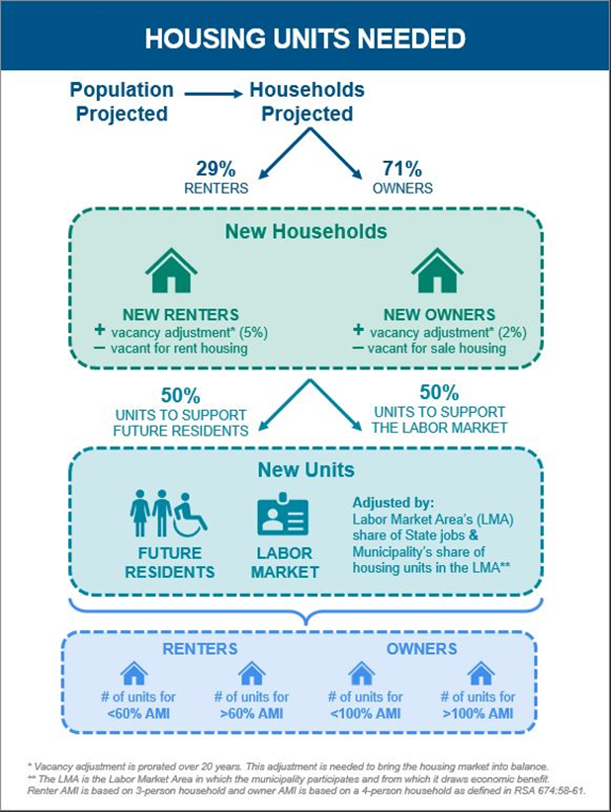
Housing Needs Projections
Methodology Overview
Developed by
Root Policy Research
V. ANALYSIS OF FUTURE CONDITIONS & TRENDS
Notes:
Common methodology across all RPCs and the statewide Housing Needs Assessment
Key Components:
projected population growth (50%)
projected employment growth (50%)
Estimates the regional housing needed to fill demand from 2020 through 2040
Total housing units needed identified in the tables are cumulative

Slide 19
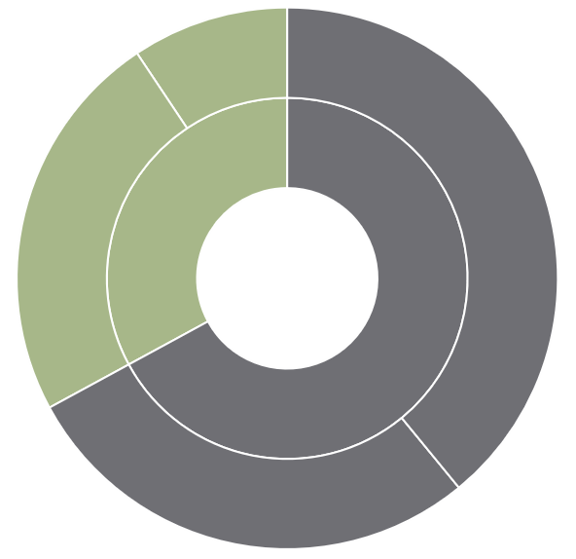
RENTER OCCUPIED BELOW 60% AMI
1,365
OWNER OCCUPIED ABOVE 100% AMI
5,688
RENTER OCCUPIED ABOVE 60% AMI
3,429
RENTER OCCUPIED 4,794
+14,563
New Units by 2040
OWNER OCCUPIED 9,769
OWNER OCCUPIED BELOW 100% AMI
4,081
Regional projections
V. ANALYSIS OF FUTURE CONDITIONS & TRENDS
Notes:
The model and housing production targets can be used as guidance for municipalities to meet the legal obligations as outlined by the New Hampshire Workforce Housing Statute.
The model provides the following outputs:
Number of housing units needed to meet the demand for:
Owner households making below 100% of the AMI
Owner households making above 100% of the AMI
Renter households making below 60% of the AMI
Renter households making above 60% of the AMI
The model provides cumulative housing production targets for 2025, 2030, 2035, and 2040.
3-person renter household at 60% AMI = $32,852
4-person owner household at 100% AMI = $101,480
*Area Median Income (AMI) utilized in the model is based on HUD Area Median incomes, aggregated by municipality to create a regional AMI.

Slide 20
Housing Needs Projections
Factors excluded from the Model:
  Seasonal Units
  Units in Poor Condition
  Demolitions
Housing markets are difficult to predict
  Interest rates, economic factors, public funding and policy
Best possible data available has been utilized
Model is based on future projected growth
Difficulty evaluating “point-in-time” housing counts
Limitations of the model
V. ANALYSIS OF FUTURE CONDITIONS & TRENDS
Notes:
*Area Median Income (AMI) utilized in the model is based on HUD Area Median incomes, aggregated by municipality to create a regional AMI.

Slide 21
Housing Opportunity & Barriers
LAND USE REGULATIONS
  Dimensional Standards
  Cluster, Open Space, or Conservation Subdivision
  Allowable Uses
  Parking Standards
  Local and State Codes (Building Energy Standards, Fire, Safety, Health Codes)
POLICIES
  Property Tax & Transfer Tax
  Tax Increment Financing
  Community Revitalization Tax Relief Incentive (79-E)
  Economic Revitalization Zones
  Opportunity Zones
  Transfer of Density Rights
OTHER CONTROLS
  Inclusionary Zoning
  Accessory Dwelling Units
  Infill Development & Redevelopment
  Missing Middle Housing
  Home Sharing or Co-living
VI. A Fair Share of Housing is More than Just a Number
Notes:
There are many levers a municipality can control that impact housing opportunity and barriers. Including….

Slide 22
Housing Opportunity & Barriers
INFRASTRUCTURE
  Transportation
  Water & Wastewater
  Broadband
HOUSING, ECONOMY, COMMUNITY DEVELOPMENT
  CDBG Grants
  Access to Childcare & Education
  Food Access
  Access to Parks, Recreation, and other Civic Infrastructure
  Housing-Related Health Concerns
VI. A Fair Share of Housing is More than Just a Number

Slide 23
Housing Opportunity: Analysis of Infrastructure
PURPOSE:
  To look at the realities of regional housing opportunity
  Consider existing infrastructure and potential extension/connections.
METHODOLOGY:
  REMOVED: Natural Features
  REMOVED: Man-made infrastructure (roads, conservation land)
  REMOVED: Existing developed land uses
  ADDED: Buffers around major roads and water/sewer lines
Weights for Co-occurrence
Dataset | Weight
Landmass after constraints | 2
Major Roads within 0.5 miles | 3
Major Roads within 1.0 miles | 2
Major Roads withing 3.0 miles | 1
Within 500' of Water and Sewer Line | 2
Withing 1000' of Water and Sewer Line | 1
VI. A Fair Share of Housing is More than Just a Number
Notes:
Natural Features: includes rivers, waterbodies, FEMA Floodplains, Wetlands, Steep slopes
Buffers around major roads (state roads or higher classification) and water/sewer lines were created and weights

Slide 24
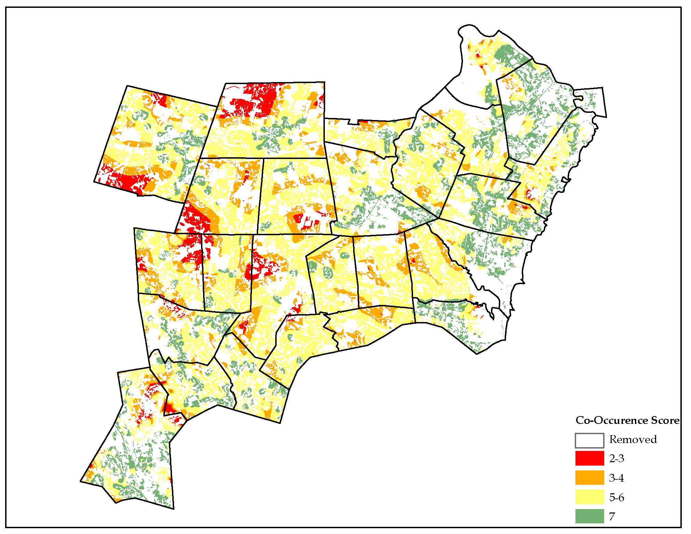
Notes:
Tool to use hand in hand with the projection numbers to identify housing opportunity areas.

Slide 25
Next Steps:
Toolbox Development: Statewide effort to develop a resource of tools available to support housing development. Includes local actions such as zoning, engagement & education, and housing policy and legislation.
Regional Conversations: RPC to identify possible next steps, which will begin with continued regional conversations, connecting housing to the regional master plan update, and integrating stakeholder input based on identified need from our municipalities.
Local Action: Will be determined on a community-by-community basis. Local municipalities may begin to identify housing goals and work towards tackling these targets. Utilize the RHNA as a resource in this process.
VII. Next Steps for Working Toward Meeting Regional Need
Notes:
[this is a broad brush, regional view – taking this data to do local analysis would be a great next step, thinking more on a town level while keeping the regional need and conversation going]
{rpc to facilitate a panel of housing stakeholders for a regional conversation]
[NOTE: Regional Master Plan Update]
Discuss toolbox, RPC next steps, Local action options

Slide 26
Next Steps: Local Action
Connect with Neighboring Municipalities and Regional Organizations
Economic Development that Supports Housing
Review Local Land Use Regulations for Housing Opportunities
Review Opportunities for Municipal Land Acquisition or Infrastructure Financing
Provide Community Education and Engagement Opportunities
Update Housing Sections of Local Master Plans
Create a Local Housing Commission or Advisory Committee
Conduct a Local Housing Needs Analysis
VII. Next Steps for Working Toward Meeting Regional Need
Notes:
Capital Improvement Programs (RSA 674:4-7 & 674:21)
Tax Increment Financing Districts
Community Revitalization Tax Relief Incentives (79-E)
Economic Revitalization Zones
Opportunity Zones

Slide 27
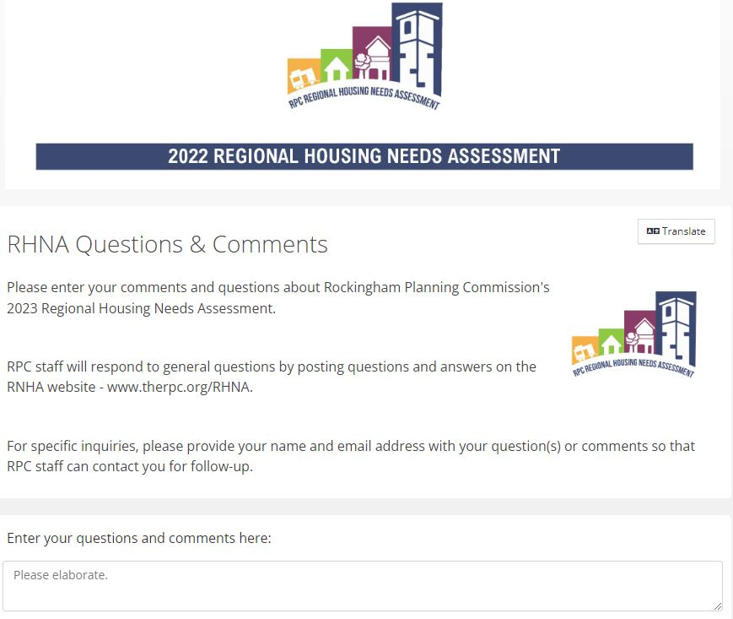
To Submit Input: www.therpc.org/RHNA
Contact Information:
Sarah Tatarczuk,
Regional Planner
statarczuk@theRPC.org
603-658-0523
Notes:
Developing an FAQ – please submit questions.

